Slide 1
Applications of Statistical Models for Images: Image Denoising
Based on following articles:
Hyvarinen at al, “Image Denoising by Sparse Code Shrinkage”
Sendur and Selesnick, “Bivariate Shrinkage Functions for Wavelet-Based Denoising Exploiting Interscale Dependency”
Simoncelli, “Bayesian Denoising of Visual Images”

Slide 2
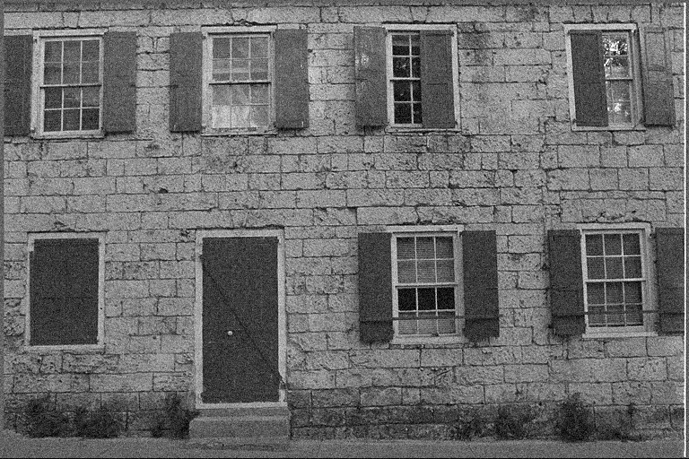

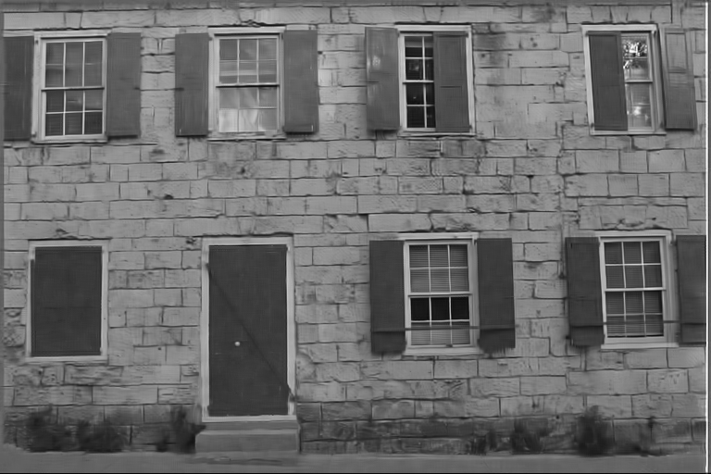
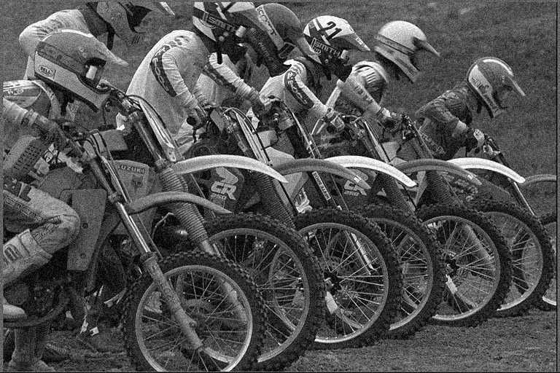


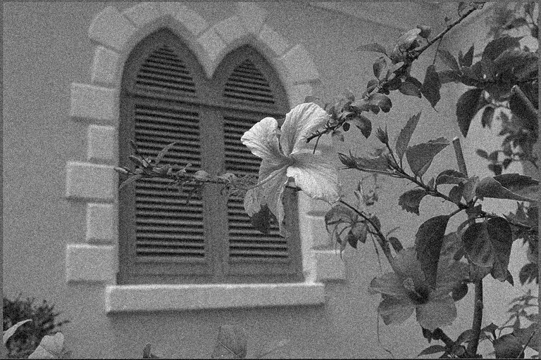


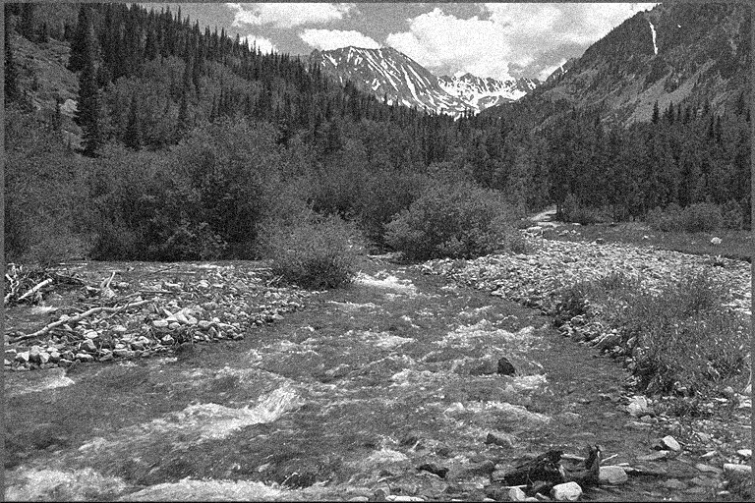
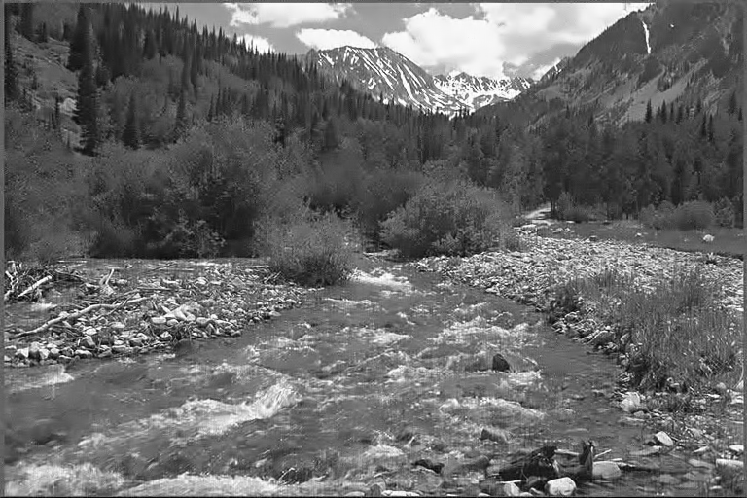

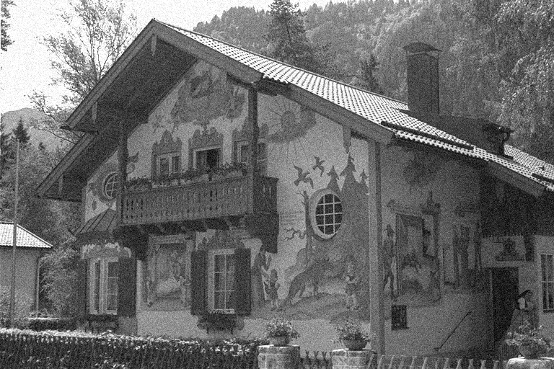


Sample State of the art result: Gaussian Noise sigma = 15

Slide 3
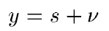
Introduction
Consider a non-Gaussian random variable s, corrupted by i.i.d. Gaussian noise of mean 0 and fixed standard deviation. Then we have:
We write the posterior probability as follows:
MAP estimate

Slide 4
MAP Estimate: Normal density
Wiener Filter
Update (MAP and also MMSE filter)

Slide 5
MAP Estimate: More General Case
No accurate closed form expression
Taylor series
First order equality
To preserve sign
Approximate closed form expression

Slide 6
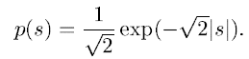
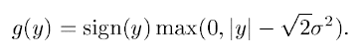
MAP Estimate: Laplace density
Soft shrinkage: reduce the value of all large coefficients by a fixed amount (taking care to preserve sign), set the remaining to 0

Slide 7
MAP: Strongly peaky density
Kurtosis higher than Laplace density
Almost equivalent to setting to zero all values below a certain threshold (hard thresholding). When|y| is small, it is set to 0 by the above shrinkage rule. When |y| is large, it is almost unaffected.

Slide 8
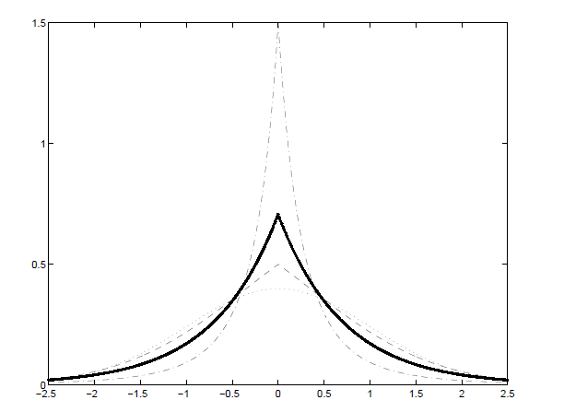
Strongly peaky density
Laplace density
Gaussian

Slide 9
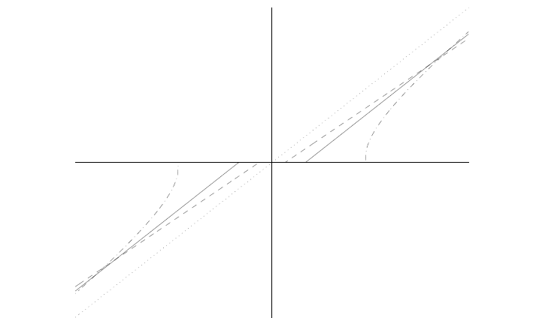
Soft thresholding
(Laplace prior)
(Almost) hard thresholding
(strongly super-Gaussian prior)

Slide 10
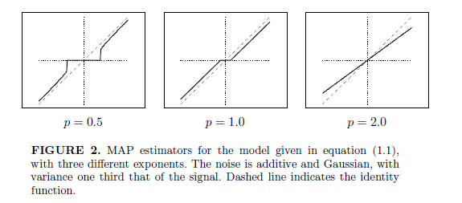
MAP Estimators

Slide 11
MMSE Estimators
We know that the MMSE estimator is given as:
For most generalized Gaussian distributions, this cannot be computed in closed form.

Slide 12
MMSE Estimators
Solution: resort to numerical computation (easy if the unknown quantity lies in 1D or 2D).
Numerical computation: Draw N samples of s from the prior on s.
Compute the following:

Slide 13
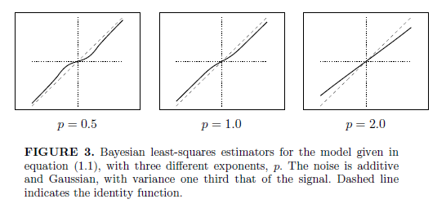
MMSE Estimators
MMSE filters (approximated numerically) for different priors

Slide 14
Which domain?
Note – these thresholding rules cannot be applied in the spatial domain directly, as neighboring pixels values are strongly correlated, and also because these priors do not hold for image intensity values.
These thresholding rules are applied in the wavelet domain. Wavelet coefficients are known to be decorrelated (though not independent). Shrinkage is still applied independently to each coefficient.
But they require knowledge of the signal statistics.

Slide 15
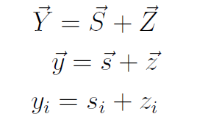
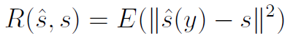
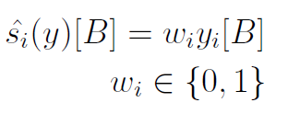
Donoho and Johnstone,
“Ideal Adaptation by Wavelet Shrinkage”,
Biometrika, 1993
Y= noisy signal, S = true signal,
Z = noise from N(0,1)
Transform coefficients of Y, S, Z in the basis B
Expected risk of the estimate
Hard thresholding estimator

Slide 16
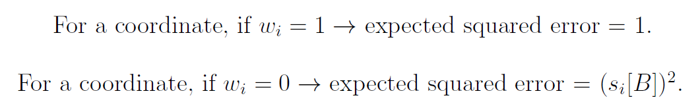
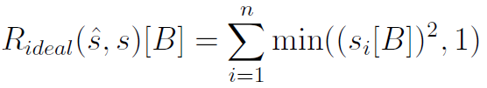
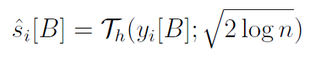
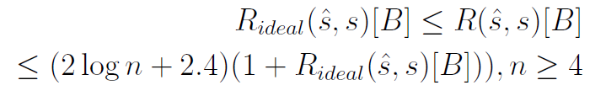
Ideal Estimator assuming knowledge of true coefficients (not practical)
Practical Hard Threshold Estimator with
universal threshold
No better inequality exists for all signals s in R^{n}

Slide 17
Wavelet shrinkage
Universal threshold for hard thresholding (N = length of the signal):
Universal threshold for soft thresholding:
In practice, it has been observed that hard thresholding performs better than soft thresholding (why?).
In practical wavelet shrinkage, the transforms are computed and thresholded independently on overlapping patches. Results are averaged. This averaging greatly improves performance and is called as “translation-invariant denoising”.

Slide 18
Algorithm for practical wavelet shrinkage denoising
Divide noisy image into (possibly overlapping) patches.
Compute wavelet coefficients of each patch.
Shrink the coefficients using universal thresholds for hard or soft thresholding (assuming noise variance is known).
Reconstruct the patch using the inverse wavelet transform.
For overlapping patches, average the different results that appear at each pixel to yield the final denoised image.

Slide 19
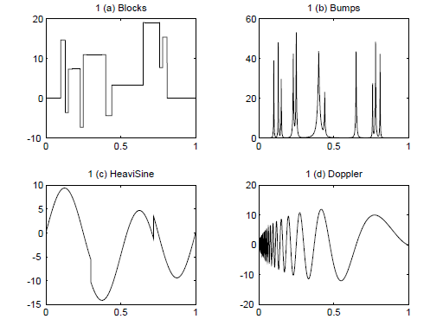
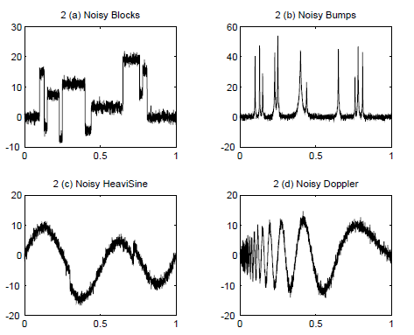
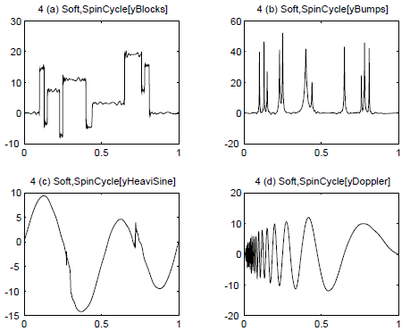
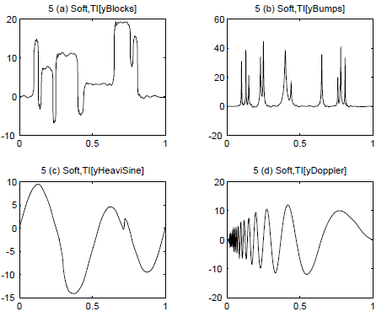

Slide 20
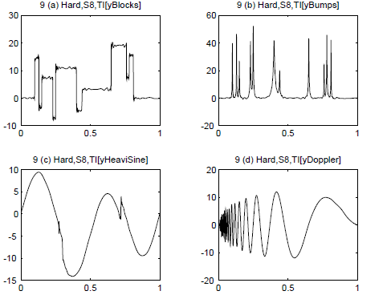

Slide 21
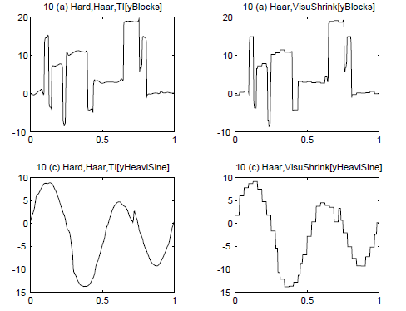
In both hard and soft thresholding, translation invariance is critical to attentuate two major artifacts:
Seam artifact at patch boundaries in the image
Oscillations due to Gibbs phenomenon

Slide 22
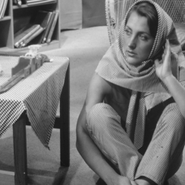



Gaussian noise standard deviation = 20 (image intensities from 0 to 255)
Hard thresholding with Haar Wavelets: without (left, bottom) and with (right, bottom) translation invariance

Slide 23

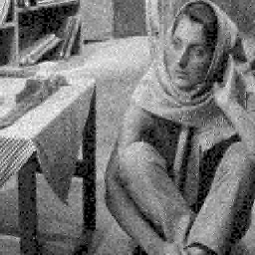


Hard thresholding with Haar Wavelets (left), DCT (middle) and
DB2 Wavelets (right) - without (top) and with (bottom) translation invariance

Slide 24






Soft thresholding with Haar Wavelets (left), DCT (middle) and
DB2 Wavelets (right) - without (top) and with (bottom) translation invariance

Slide 25
Comparison of Hard (left) and Soft (right) thresholding with DCT:
without (top) and with (bottom) translation invariance

Slide 26
Bivariate shrinkage rules
So far, we have seen univariate wavelet shrinkage rules.
But wavelet coefficients are not independent, and these rules ignore these important dependencies.
Bivariate shrinkage rule: jointly models pairs of wavelet coefficients and performs joint shrinkage.
Ref: Sendur and Selesnick, “Bivariate Shrinkage Functions for Wavelet-Based Denoising Exploiting Interscale Dependency"

Slide 27
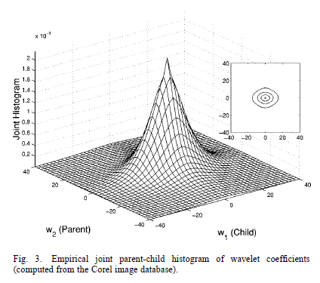
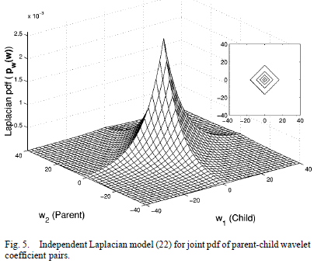
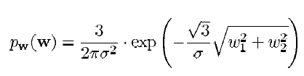
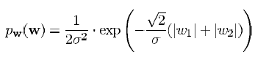
Can be approximated by
Product of two independent Laplacian distributions
Not the same!

Slide 28
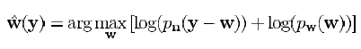
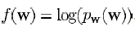
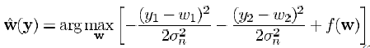
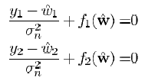
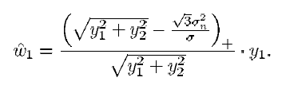
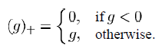
MAP
Joint shrinkage rule (likewise for w₂)

Slide 29
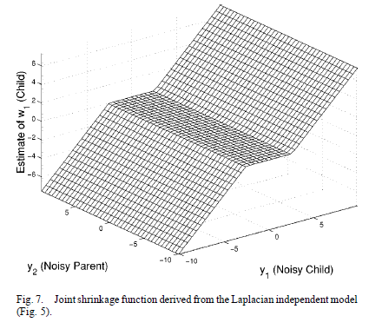
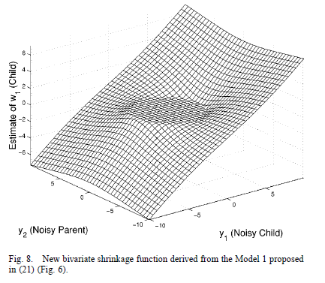
Circular deadzone
Rectangular deadzone

Slide 30
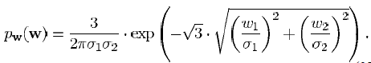
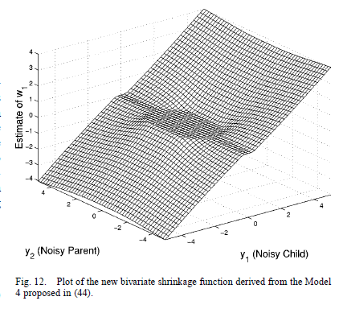
But variance (and hence scale parameter) for parent and child wavelet coefficients may not be the same!
Corresponding dead-zone turns out to be elliptical.
But there is no closed-form expression! Numerical approximations required to derive a shrinkage rule.
Improvement in denoising performance is marginal if at all!

Slide 31
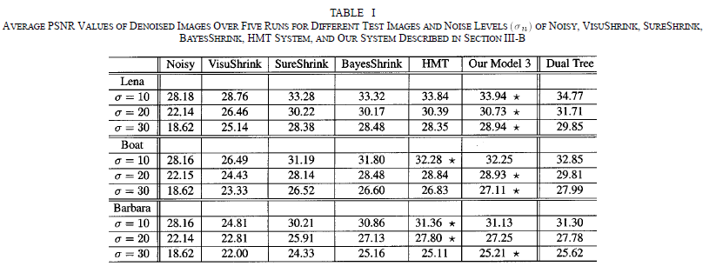

Slide 32
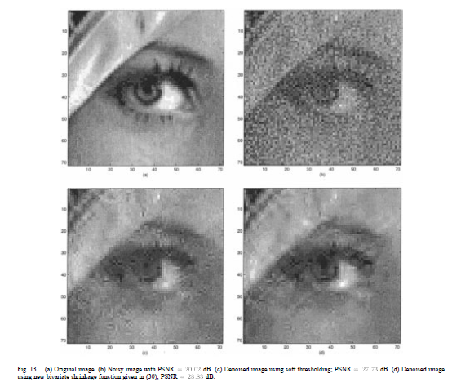

Slide 33
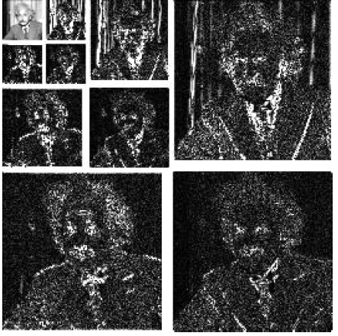
Another model: joint wavelet statistics for denoising
Ref: Simoncelli, “Bayesian denoising of visual images in the wavelet domain”

Slide 34
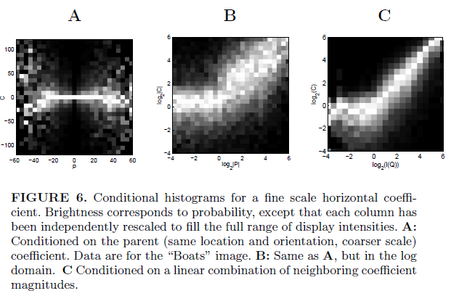
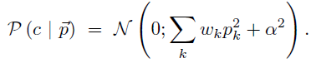
Histogram of log(child coefficient^2) conditioned on a linear combination of eight adjacent coefficients in the same sub-band, two coefficients at other orientations and one parent coefficient

Slide 35
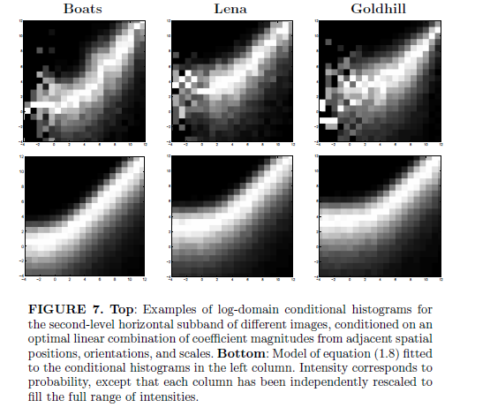

Slide 36
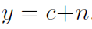



Observed noisy child coefficient
Child coefficient (to be estimated)
MAP estimate (HOW??)
But this assumes the parent coefficients, i.e. the {p_{k}} are known
Hence, we have a two-step approximate solution:
Estimate the neighbor-coefficients using marginal thresholding
Perform a least-squares fit to determine weights and other parameters
Then compute the “denoised” child coefficient

Slide 37




Comparisons

Slide 38


Slide 39




Slide 40
Summary
MAP estimators for Gaussian, Laplacian and super-Laplacian priors
MMSE estimators for the same
Universal thresholds for hard and soft thresholding
Translation Invariant Wavelet Thresholding
Comparison: Hard and soft thresholding
Joint Wavelet Shrinkage: Bivariate
Joint Wavelet Shrinkage: child and linear combination of neighboring coefficients

